Slide 1
Google Search data to Power BI
Analyze your Google search data in Power BI

Slide 2
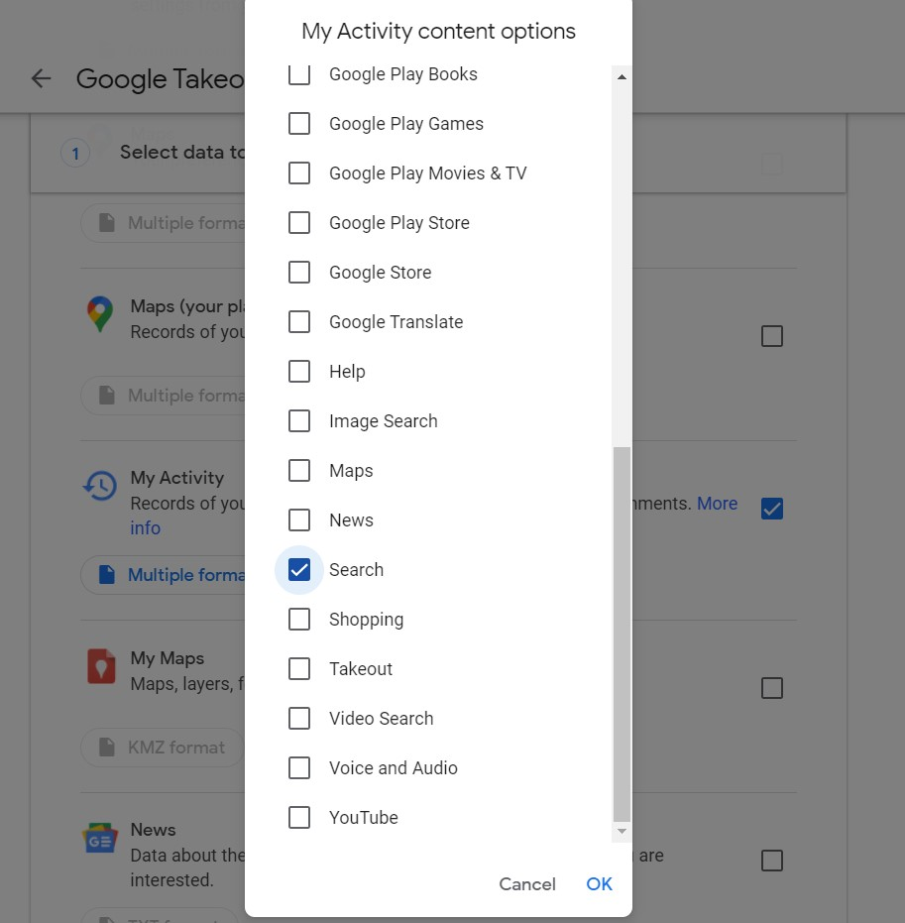
Navigate to https://takeout.google.com/ click Manage exports click Create new exports click Deselect all and select only My Activity click All activity data included click Deselect all and select only Search then OK

Slide 3
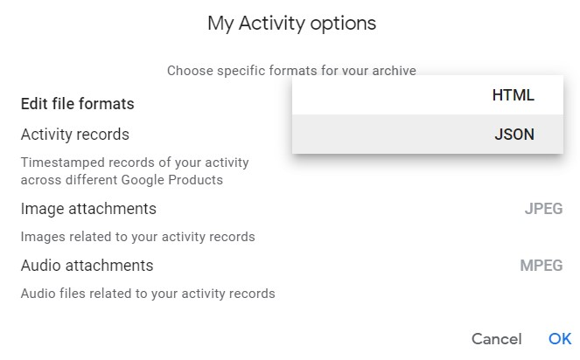
Click Multiple formats from Edit file formats select JSON then OK

Slide 4
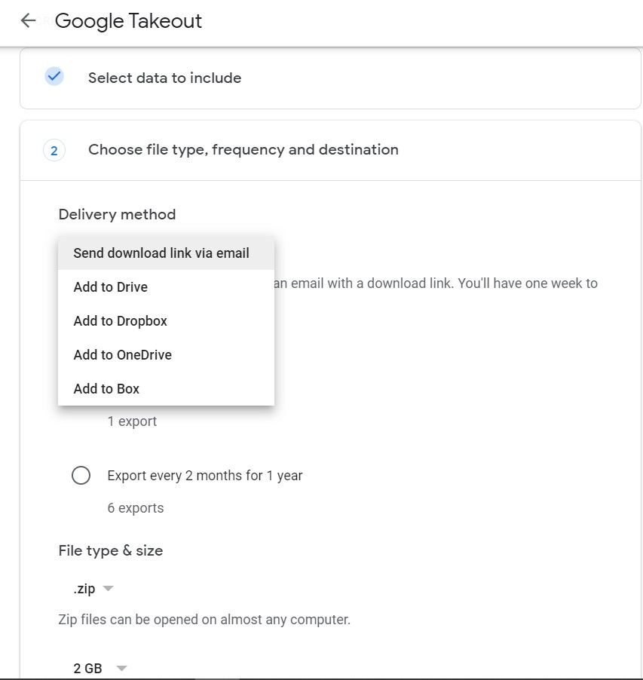
Click Next step then from Delivery method choose Add to OneDrive Finally click Create export

Slide 5
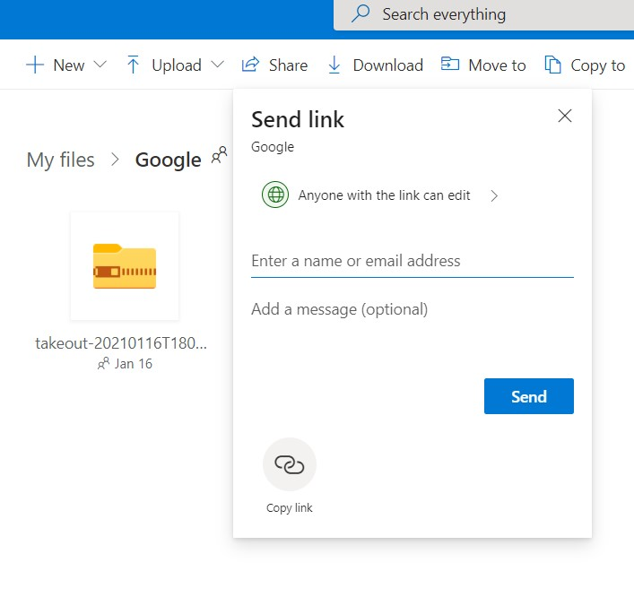
Soon after you complete the steps a folder Google with a zip file will appear in your OneDrive Select Share then Copy link

Slide 6
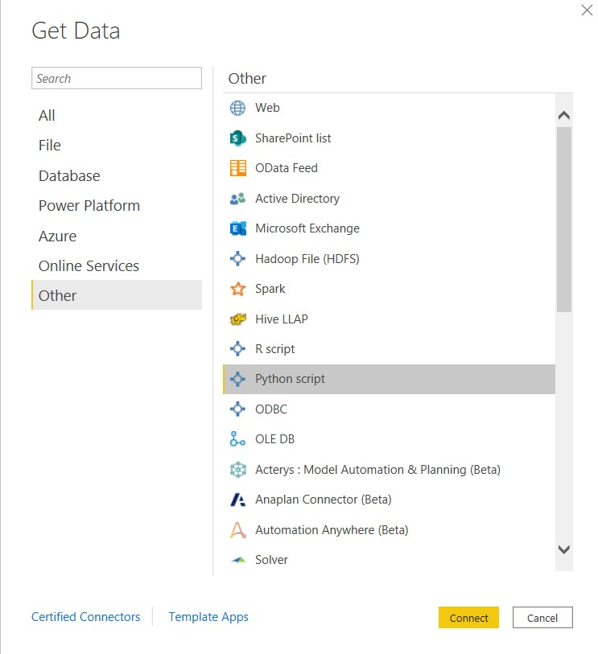
In Power BI Desktop click Get Data click Other then Python script then Connect

Slide 7
# Input any OneDrive URL onedrive_url = 'Paste here the link you copied from OneDrive' import numpy as np imort pandas as pd import requests, zipfile, io, base64 def create_onedrive_directdownload (onedrive_link): data_bytes64 = base64.b64encode(bytes(onedrive_link, 'utf-8')) data_bytes64_String = data_bytes64.decode('utf-8').replace('/','_').replace('+','-').rstrip("=") resultUrl = f"https://api.onedrive.com/v1.0/shares/u!{data_bytes64_String}/root/content" return resultUrl # Generate Direct Download URL from above Script direct_download_url = create_onedrive_directdownload(onedrive_url) r = requests.get(direct_download_url) z = zipfile.ZipFile(io.BytesIO(r.content)) df = pd.read_json(z.extract('Takeout/My Activity/Search/My Activity.json')).loc[:,['title','titleUrl','time']] # You might want to change to your Time Zone df['time'] = pd.to_datetime(df.time,infer_datetime_format=True,utc=True).dt.tz_convert('Europe/Copenhagen') # Create a date column df.loc[:,'date'] = pd.to_datetime(df['time']).dt.date # Create a column for Visited and Searched for df = df.assign(action= lambda x: np.select( [x.title.str.startswith('Visited'), x.title.str.startswith('Searched for')], ['Visited','Searched for']))#.query("action=='0'") # Extract only the text without (Visited & Searched for) df = df.assign(text= lambda x: np.select( [x.title.str.startswith('Visited'), x.title.str.startswith('Searched for')], [x.title.str[8:],x.title.str[13:]])) # Get length of text field df = df.assign(text_len = lambda x: x.text.str.len()) # Get first word form each Searched for row df['first_word'] = np.where(df.action == 'Searched for',df.text.str.partition(' ')[0],None)
At the top of the script,
https://github.com/Georgi-Petkov/Googel-Search-takeout-to-Power-BI
paste your copied link
from OneDrive then
Copy the whole script and
paste it in the Python script
Window and click OK
At this point you will see a folder
Python – select df
Happy exploring

